Slide 1
Subsidies Are They Worth It?
Gary L. Hunt
School of Economics
University of Maine
E2TECH Forum
University of Maine
October 26, 2011
School of Economics

Slide 2
SUBSIDIES
Payments by consumers funded by above market prices (rates) for wind projects
Blended into the rate base (often with cap on rate impact)
Payments by governments funded by taxpayers
Publically funded R&D
Tax credits and accelerated depreciation
Cash grants (e.g., U.S. Department of Energy 30% grant)
Loan guarantees
Subsidies to producer inputs (e.g., transport infrastructure, fuel production)
Statutory limitations on liability (nuclear)

Slide 3
Cumulative Financial and R&D Subsidies
Three Electricity Generating Technologies
(billions of 2007$)
Source: J. Badcock and M. Lenzen. ”Subsidies for Electricity-generating Technologies: A Review,”
Energy Policy 38 (2010): 5038-5047.

Slide 4
Rationales for Subsidies
Whether subsidies are worth it depends on benefits
Reduction of project costs through R&D and learning – by - doing
Avoidance of hidden costs related to health and environmental damages
Subsidies are worth it if the benefits more than offset the costs of the subsidies
Subsidy costs range from $1.10 to $1.50 per dollar of subsidy depending on the revenue source used
Ballard and Fullerton (1992)
So benefits achieved should range from 1.1 to 1.5 times subsidy amounts

Slide 5
Reduction of project costs through R&D and learning curve effects
An immature industry has relatively high costs to begin with and therefore cannot compete on its own in the marketplace against mature industries.
Subsidies for R&D and for the actual building out of projects lower costs over time
As increasing numbers of generating units are built (e.g., wind turbines), costs fall because of “learning – by – doing”
As the industry matures, costs fall and the industry can begin to compete on its own.
Subsidies early in the industry’s development yield cost savings in the longer term

Slide 6
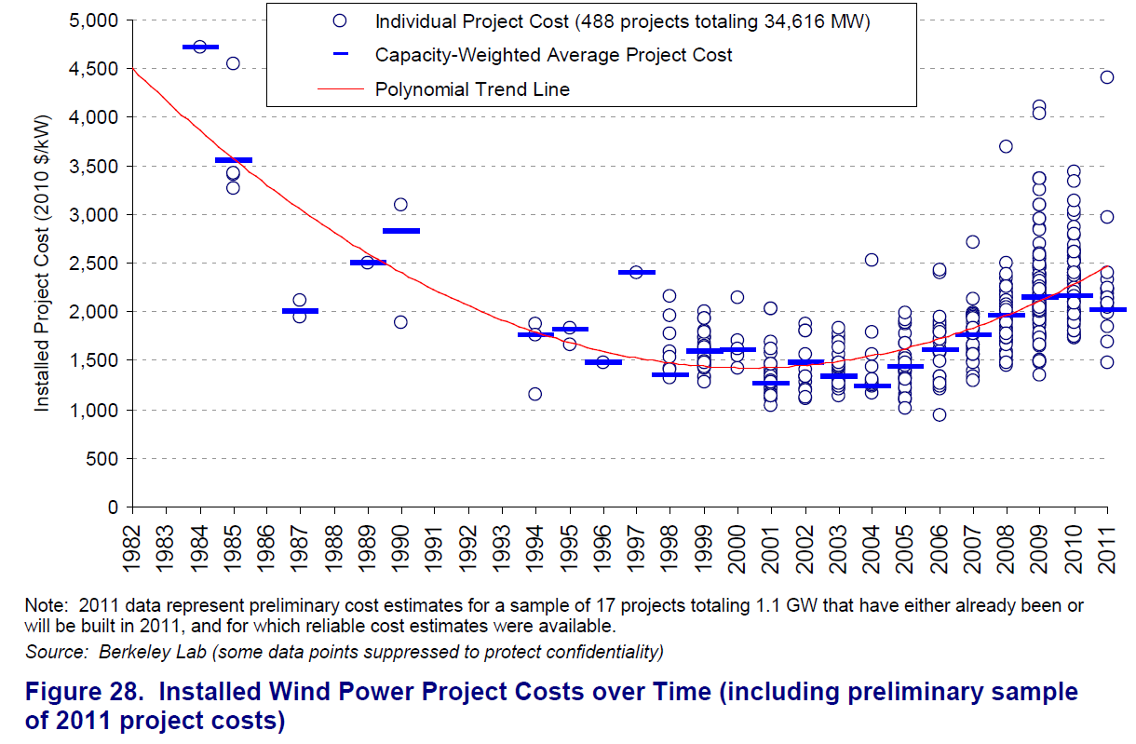
Wiser, R. and Bollinger, M. 2010 Wind Technologies Market Report, Lawrence Berkeley National Laboratories (June 2011).

Slide 7
Avoidance of hidden costs related to health and environmental damages
Electricity generation based on burning fossil fuels creates relatively large environmental and health costs
This is especially true for coal-based generation
For electricity generation based on wind energy, studies find that such costs are relatively small
A properly functioning electricity market would include these hidden costs in the price of electricity but this is not the case in the current electricity market
This situation leads to an unlevel playing field on which wind power is artificially put at a competitive disadvantage
A subsidy for wind power can address the artificial cost advantage enjoyed by fossil fuel technologies

Slide 8
Measuring Costs
Full economic costs are called “social costs.”
Social costs include both
Private costs
Building, financing, and operating generation plant/farm
External costs
Health and environmental damages
Social costs = Private Costs + External Costs

Slide 9
Social Costs ($/kWh)
Intergenerational justice
Insurance against catastrophe
Fracking
Health
?
Sources: Energy Information Administration (2010); Epstein, P.R. et al (2011); Howarth, R.W., et al. (2011); Muller, N. Z., et
al. (2011); National Research Council, U.S. National Academy of Sciences (2009); Stern, N (2006); Weitzman, M.L
(2007).

Slide 10
Subsidies for both Learning and Hidden Cost Problem ($/kWh)

Slide 11
Are Subsidies Worth It?
Do they lower private costs through R&D and learning curve effects?
Yes for onshore wind
From over $0.20/kWh down to $0.10/kWh
Potential exists for similar outcome for offshore wind
U.S. DOE goal is for $0.07/kWh - $0.09/kWh over time

Slide 12
Are Subsidies Worth It?
Can they correct for any hidden costs that lead to an unlevel playing field putting wind artificially at a competitive disadvantage resulting in a higher social cost of electricity?
Yes
The difference in full cost between wind and NGCC is less than 1.1 - 1.5 times the full cost difference between wind and the highest cost generation technologies
Coal
Oil/gas Turbines
So the social cost savings achieved by retaining wind generation through subsidies exceeds the social costs of the subsidies themselves

Slide 13
Are Subsidies Worth It?
Subsidies for avoidance of hidden costs can be eliminated when emissions charges are placed on fossil fuel generated electricity to fully incorporate its health and environmental costs into the electricity market
Subsidies for R&D and “learning–by–doing” would remain, especially for offshore wind

Slide 14
Economical Generation Mix
Wind could displace coal and oil/gas turbines
These currently account for about 25% of the electricity generation in New England
Natural gas (NGCC) is about 35%
Wind and natural gas work well together in the generation portfolio
A 20% - 25% share for wind in the portfolio is feasible
NREL, Eastern Wind Integration and Transmission Study (2009)
ISO New England, New England Wind Integration Study (2010)

Slide 15
Source: http://www.iso-ne.com/nwsiss/grid_mkts/enrgy_srcs/index.html

Slide 17
Yes, Subsidies Can Be Worth It
Factors influencing net social benefits from wind subsidies include
Continued learning effects with wind expansion (esp. offshore)
Careful siting
Health and environmental costs not fully accounted for
Coal and oil/gas turbine hidden costs
Methane leakage (CO2 emissions as high as coal)--shale
Water pollution issues with hydraulic fracturing--shale
Other health and environmental costs of “fracking”--shale
Enhancing energy security through long – run electricity price
stability under fixed price PPA
Fuel mix diversification to avoid over-reliance on natural gas
Storage and transmission developments and costs

Slide 18
References
Allaire, M. and S. Brown. “Eliminating Subsidies for Fossil Fuel Production: Implications
for U.S. Oil and Natural Gas Markets,” Issue Brief 09-10, Resources for the Future (2009).
Badcock, J. and M. Lenzen. “Subsidies for Electricity-generating Technologies: A Review,”
Energy Policy 38 (2010): 5038-5047.
Ballard, C.L. and D. Fullerton. “Distortionary Taxes and the Provision of Public Goods,” Journal of
Economic Perspectives 6 (Summer 1992): 117-131.
Energy Information Administration (EIA). Annual Energy Outlook 2011 (December 2010)
http://www.eia.doe.gov/oiaf/aeo/electricity_generation.html
Energy Information Administration (EIA). Electric Power Monthly (March 2011).
Environmental Law Institute. “Estimating U.S. Government Subsidies to Energy Sources: 2002-2008”
(September 2009).
Epstein, P.R. et al. “Full Cost Accounting for the Life Cycle of Coal,” Annals of the New York Academy
of Sciences, 1219 (2011): 73-98.
Howarth, R.W., et al. “Methane and the Greenhouse-gas Footprint of Natural Gas from Shale
Formations: A Letter,” 106 (2011): 679-690.

Slide 19
References
ISO New England. http://www.iso-ne.com/nwsiss/grid_mkts/enrgy_srcs/index.html
ISO New England, New England Wind Integration Study (2010)
Muller, N. Z., R. Mendelsohn, and W. Nordhaus. “Environmental Accounting for Pollution in
the United States Economy,” American Economic Review 101 (August 2011): 1649-1675.
National Renewable Energy Labs (NREL). Eastern Wind Integration and Transmission Study (2009).
National Research Council, U.S. National Academy of Sciences. The Hidden Costs of Energy (2009).
Stern, N. Review on the Economics of Climate Change. HM Treasury, U.K. (2006).
Weitzman, M.L. “A Review of The Stern Review on the Economics of Climate Change,” Journal of
Economic Literature, XLV (September 2007): 703-724.
Wiser, R. and Bollinger, M. 2010 Wind Technologies Market Report, Lawrence Berkeley National
Laboratories (June 2011).

Slide 20
Additional Reference Slides

Slide 21
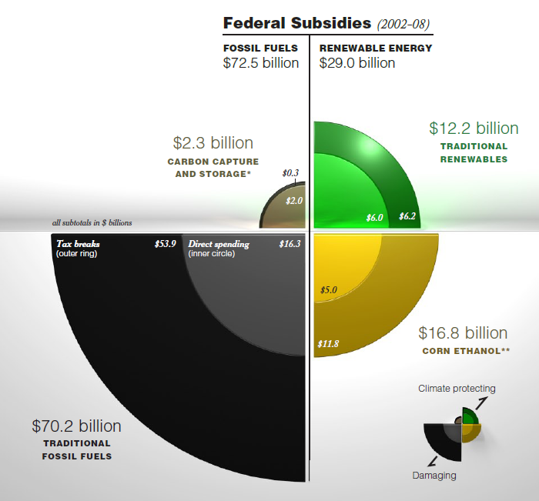
Source: Environmental Law Institute, Estimating U.S. Government Subsidies to Energy Sources:
2002-2008 (September 2009)

Slide 22
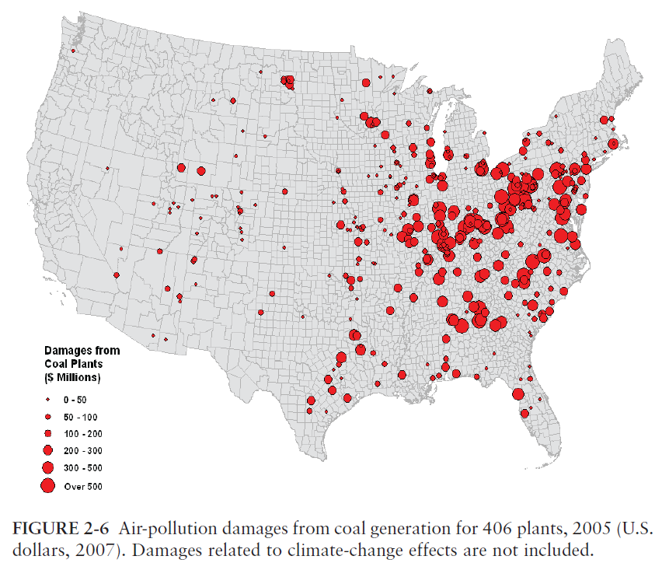
National Research Council, U.S. National Academy of Sciences. The Hidden Costs of Energy (2009).

Slide 23
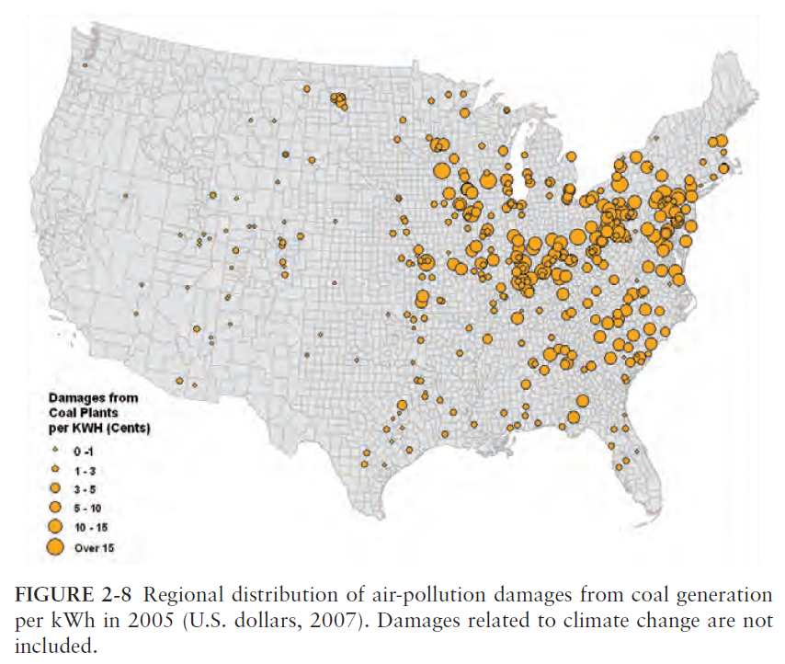
National Research Council, U.S. National Academy of Sciences. The Hidden Costs of Energy (2009).

Slide 24
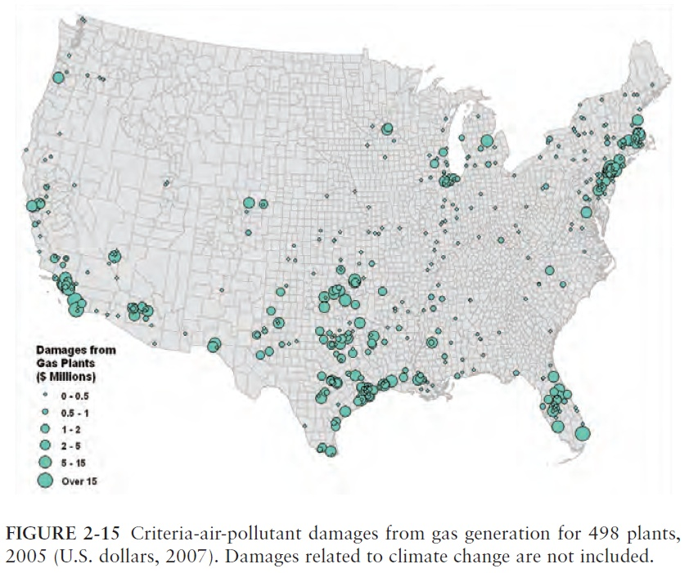
National Research Council, U.S. National Academy of Sciences. The Hidden Costs of Energy (2009).

Slide 25
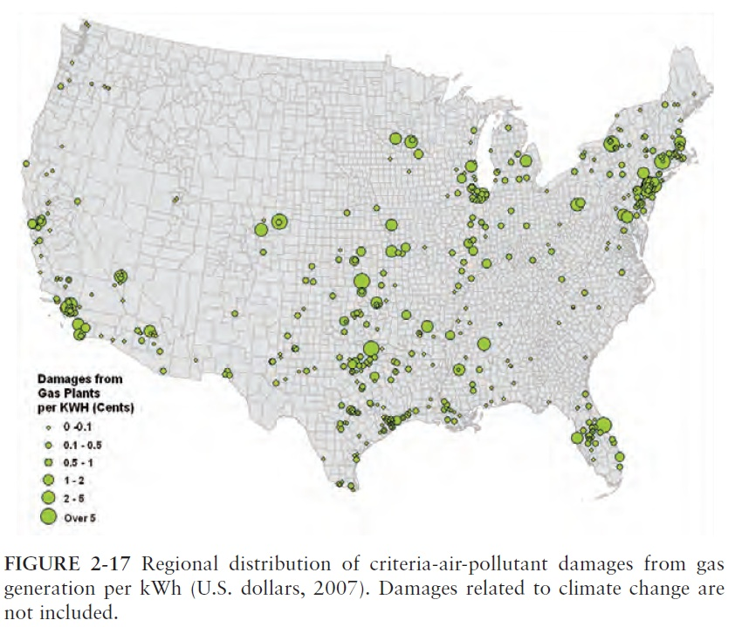
National Research Council, U.S. National Academy of Sciences. The Hidden Costs of Energy (2009).

Slide 26
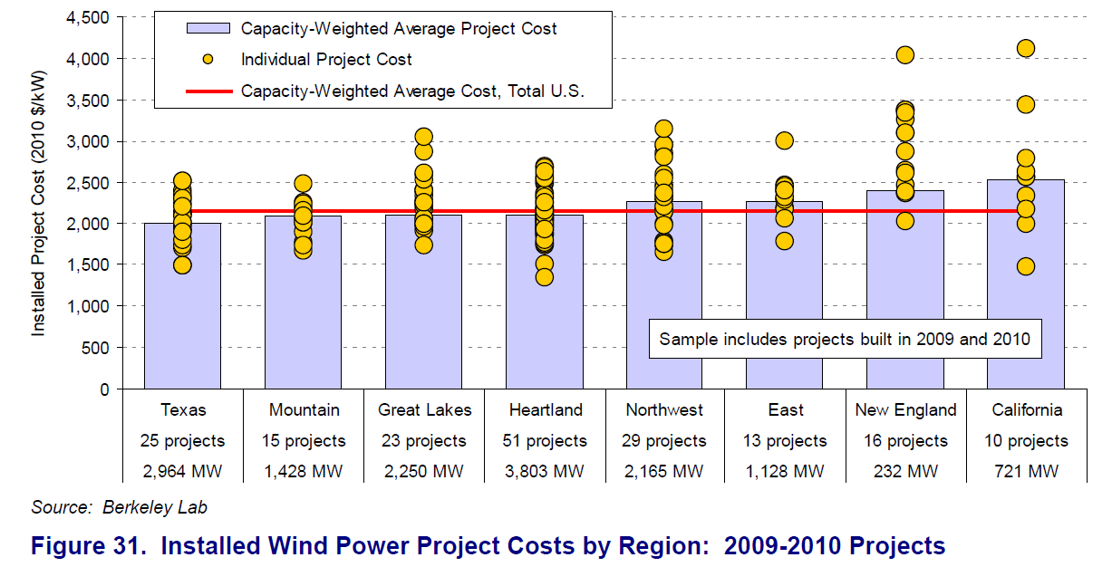
Wiser, R. and Bollinger, M. 2010 Wind Technologies Market Report, Lawrence Berkeley National Laboratories (June 2011).

Slide 28
Source: http://www.iso-ne.com/nwsiss/grid_mkts/enrgy_srcs/index.html

Slide 29
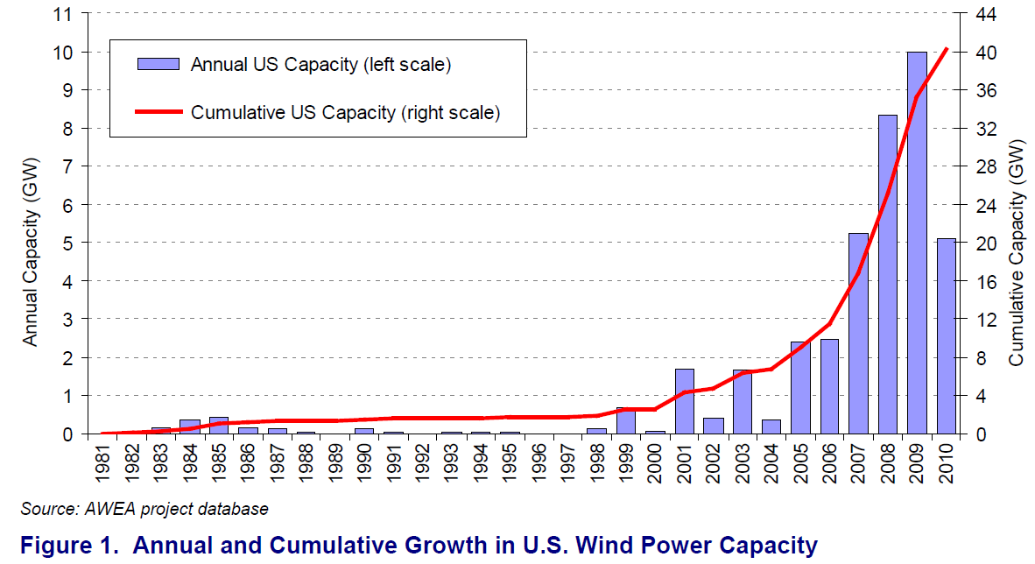
Wiser, R. and Bollinger, M. 2010 Wind Technologies Market Report, Lawrence Berkeley National Laboratories (June 2011).

Slide 30
Levelized Cost of Energy
Private Costs
Capital costs + O&M costs + Fuel costs
External (hidden) costs
Health + Environmental
Social Costs = Private Costs + External Costs
Sum social costs over life of the generating plant
Divide by expected plant kWh output over its life
Levelized Cost of Energy (LCOE) = Sum of social costs / Expected kWh
Estimates of LCOE based on social costs excluding current subsidies*
* Note: Subsidies to fuel providers through preferential tax treatment and transport infrastructure pricing are not accounted for. These typically are estimated to be
quite small on a per kWh basis (Allaire and Brown, 2009).

Slide 31
A Note on Jobs and Economic Development
If the subsidies are worth it, then it is economically efficient for additional labor and other productive resources to be utilized in the wind sector of our economy.
Under these circumstances the green jobs are a reflection of the economic advantages of green power (lower social cost).
Economic development and job growth associated with the expansion of the sector is consistent with the sector’s ability to provide electrical energy with cost savings over other potential alternatives.

